Slide 1
Think Like an Attacker to Protect Your App
Peter Tefft
Software Engineer at PreEmptive

Slide 2
Who I Am
Peter Tefft
Software Engineer @ PreEmptive
Developer of PreEmptive Protection - DashO and its Gradle integrations
Board Game Enthusiast
Ptefft@preemptive.com

Slide 3
Things I Hope You’ll Take Away Today
The risks that these attacks pose to your app
Ways in which attackers might approach your app
A set of tools and techniques that you can use to protect your app

Slide 4
What do Attackers try to do?
Steal Algorithms and Workflows
Produce Copycat or Counterfeit Applications
Discover Security Vulnerabilities
Steal Sensitive Data
Access Gated Functionality/Content
Notes:
Steal Algorithms and Workflows -> Oil fields story (trade secrets)
Produce Counterfeit Applications -> User data loss: Counterfeit banking apps, Market share loss: Yoga App, Reputational damage: you-know-who story
Discover security vulnerabilities -> Insecure storage of data on the client side, server side vulnerabilities. (best not to write in vulnerabilities but…)
API Scraping
Steal Data -> Credentials, Financial Data, Medical Data, Copyrighted Material (DRM)
Regulations (HIPAA, PCI)
Access Gated Functionality -> Trucking story, Sharing economy story

Slide 5
Static Analysis

Slide 6
Decompilation
The process of reproducing source code from compiled code
Dex -> Java Bytecode -> Java Source Code
IL -> C# Source Code
Procyon, JADX, FernFlower, JD-GUI…
Makes your code…
Easy to understand
Easy to copy
Easy to find vulnerabilities within
Easy to modify and rebuild

Slide 7
Decompilation Demo

Slide 8

Static Defenses

Slide 9

Renaming Obfuscation
Renames classes, methods, and fields
com.preemptive.crypto.SuperSecretCipher -> a
Offered in Android and Java by R8/ProGuard – little configuration required
Works well alongside other obfuscation techniques
Notes:
What is it? What’s good about it
How do you get it? How do you configure it?
Not a complete solution. What does Google consider it to be for?

Slide 10
Renaming Obfuscation Decompiled
Using the same MoneyBank sample
Using some non-default rules:
-allowaccessmodification
-repackageclasses
Notes:
Talk about non-default rules to enhance protection

Slide 11
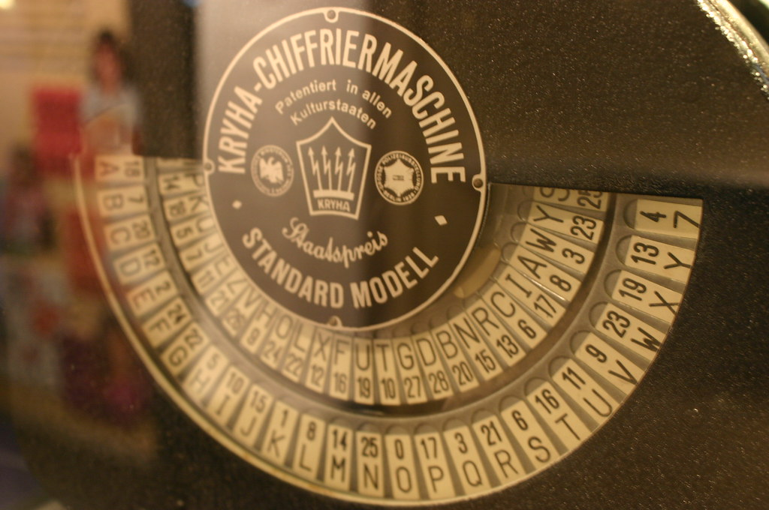
String Encryption
Replaces string constants with encrypted versions
Unencrypted string constants can give a lot of insight into your code
Requires additional instructions to be added to the code, but not too many
Notes:
Connect to renaming demo

Slide 12

Control Flow Obfuscation
Changes the flow of method code
Can frustrate or stop decompilers
Some performance penalty

Slide 13
Static Protection Demo

Slide 14

Runtime Analysis and Attacks

Slide 15
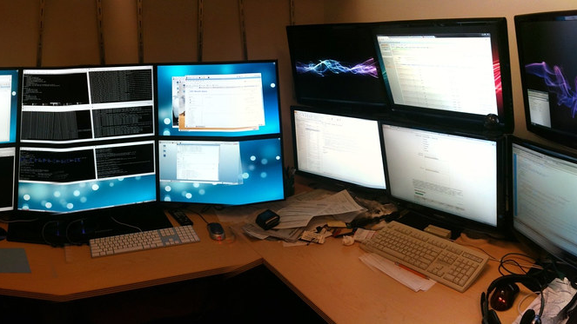
Debugging Tools and Hooking Frameworks
Debugging tools: The same tools that you use during development
Hooking tools: Attach callbacks to methods in an app
Frida, Substrate, Xposed, Drozer, ARTDroid…
Inspect and modify data at runtime
Modify app behavior and hit unexpected states without changing the app
Notes:
Connect to String Encryption

Slide 16
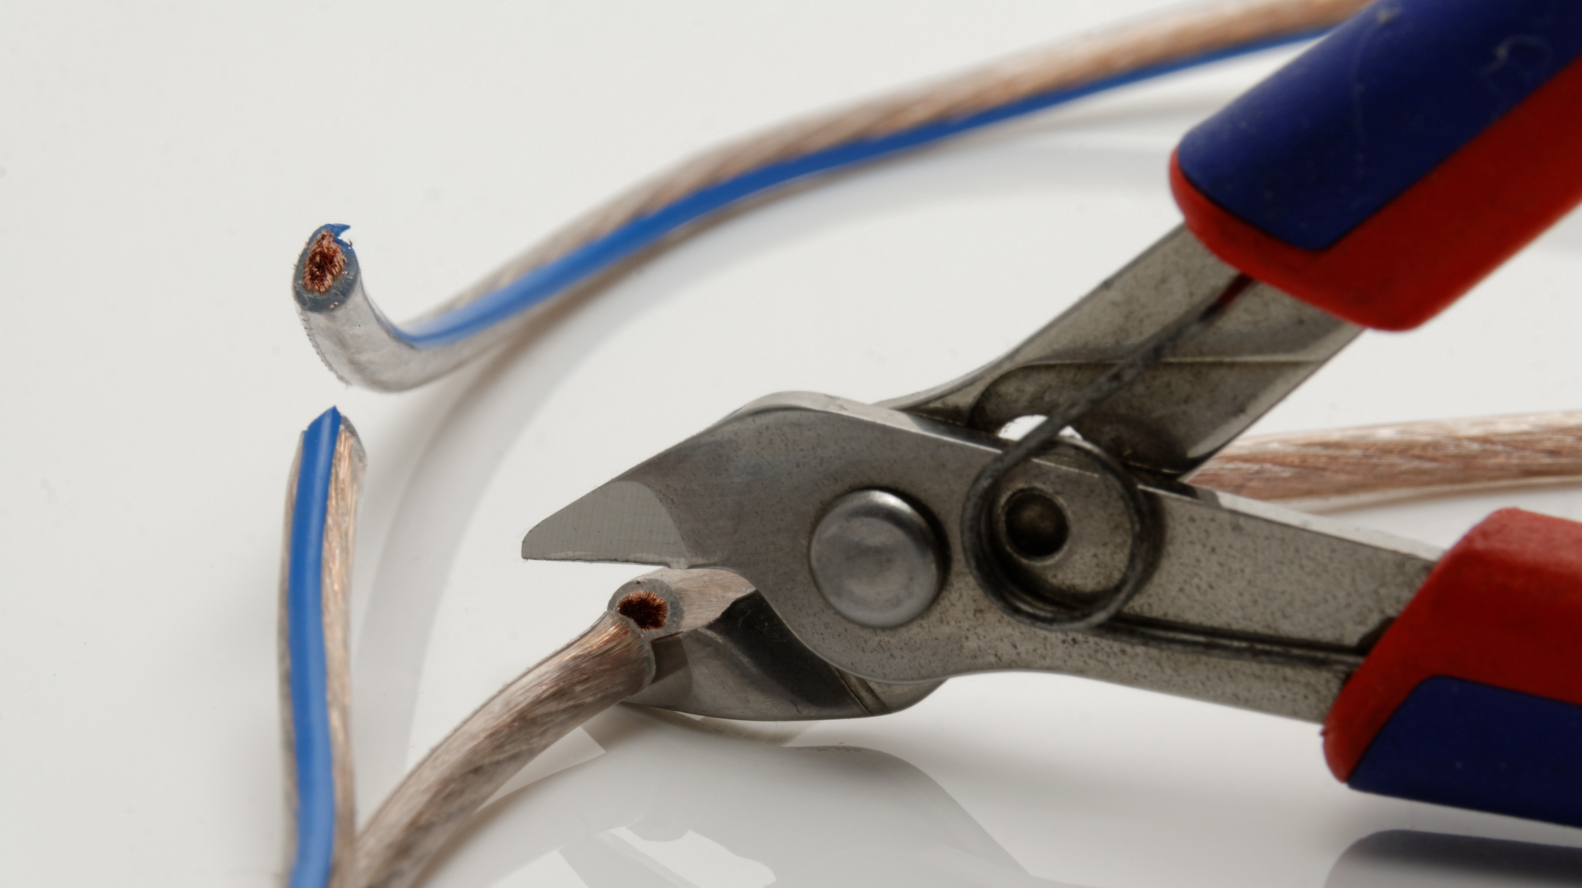
Tampering
Your app can be altered and repackaged
Code changes, manifest changes, resource changes
Will be signed with a different certificate
Your app can be manipulated externally
Modification of behavior or spying via another app
Malware or launcher apps
User may or may not be complicit

Slide 17
Tampering Demo
Modify and replace code in APK
Convert classes.dex to a jar
Make a new jar with our modified class
Convert the new jar into a new classes.dex
Make an APK with a new classes.dex and resign it

Slide 18
Why Runtime Attacks Matter
Undermines static protections
Allows access to sensitive data in memory
Exposes security vulnerabilities
Access gated content/functionality, cheating
Counterfeit apps
Notes:
Connect back to string encryption/debugging
Connect to DRM concerns

Slide 19

Runtime Defenses

Slide 20

Runtime Checks
Check your environment at runtime
Is Debugging enabled? Is there a debugger attached?
Is the device rooted? An emulator?
Is there a hooking framework around?
Has the package been tampered with?
Ad-hoc checks are hard to maintain

Slide 21
Tamper Check Demo

Slide 22
Protections are Better Together

Slide 23

Questions

Slide 24
Images
https://www.maxpixel.net/Skull-Pirates-Flag-Pirate-Crossbones-Jolly-Roger-4249213
https://www.pexels.com/photo/computer-cyber-hacker-hacking-163009/
https://commons.wikimedia.org/wiki/File:Java_source2.svg
https://www.flickr.com/photos/hernanpc/7115374283 by Hernán Piñera (CC Attribution/ShareAlike)
https://www.pexels.com/photo/computer-cyber-hacker-hacking-163009/
https://www.flickr.com/photos/peterhess/2976755407 (CC Attribution)
https://www.flickr.com/photos/stockcatalog/26406043977 (CC Attribution)
https://www.flickr.com/photos/wfryer/5165070448 (CC Attribution-ShareAlike)
https://commons.wikimedia.org/wiki/File:Fish-hook.JPG (CC Attribution-ShareAlike)
https://www.flickr.com/photos/mnuernberger/21080094622 (CC Attribution)
https://www.needpix.com/photo/download/890298/alarm-system-emergency-alarm-security-yellow-red-lamp-free-pictures-free-photos
https://www.flickr.com/photos/lennartt/7767347502 (CC Attribution)
https://en.m.wikipedia.org/wiki/File:Loudoun_Castle_wax_seal.jpg
https://pixabay.com/photos/marionettes-puppets-strings-801970/
https://pxhere.com/en/photo/1059270
https://www.flickr.com/photos/ideonexus/5175383269 (CC Attribution)
https://pxhere.com/en/photo/1190825
https://pxhere.com/en/photo/1048601
https://www.flickr.com/photos/ideonexus/5175383269 (CC Attribution)
https://commons.wikimedia.org/wiki/File:Peanut_Butter_and_Jelly_Sandwich.jpg (CC Attribution-ShareAlike)

Slide 25

Thank You!
Stop by our booth!
Reach me at Ptefft@preemptive.com
https://github.com/preemptive/DashO-MoneyBank
Check Out Assembly Language: The (Sega) Genesis of Programming tomorrow.

